Slide 1
EMSE Master Scripts 3.0 Installation and Upgrade Guide
John Schomp – Director, Services

Slide 2

Master Script 3.0 Features
Feature | EMSE 2.0 | EMSE 3.0
Master scripts provide basic set of variables, standard functions, flow of execution
Variable branching provides object-orientation to record type
Source Code Control
Standard JavaScript syntax, ability to use { } blocks, multi-line code, etc.
Develop scripts using text editor
Build process will deploy scripts without accessing standard choices or scripts in AA
Local copy of all scripts on the development machine
Ability to download script code for other projects
Script Tester for Unit Testing (before commit to SVN)
Greatly improved error handling

Slide 3
Event Script Development Flow
Modify script in text editor
Commit change to SVN with comments
Push the “build” into AA
Test within AA
Leverage Script Tester to unit test change

Slide 4
Loading Scripts
Option 1: Manually (zip file)
Option 2: Import scripts and config std choices automatically via Data Manager
Link events to new master scripts

Slide 5
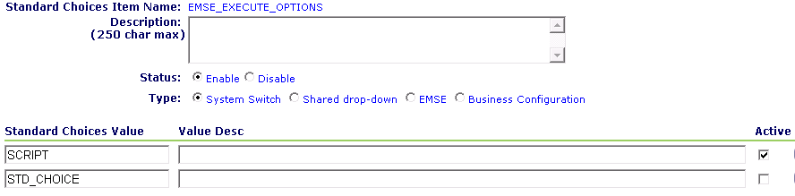
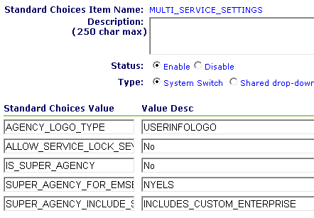
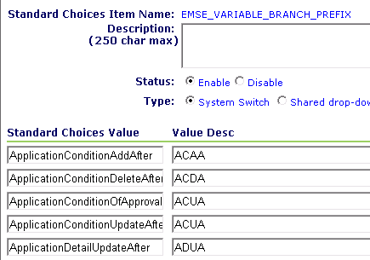
Configurations (1 of 2)
Activates scripts, standard choices, or both
Optional custom include file for all agencies within a superagency
Event to prefix mapping, used to locate scripts for each event

Slide 6
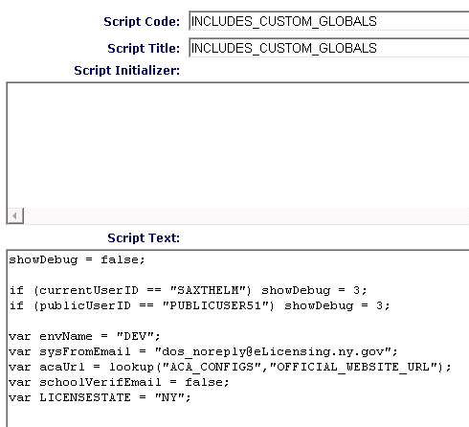
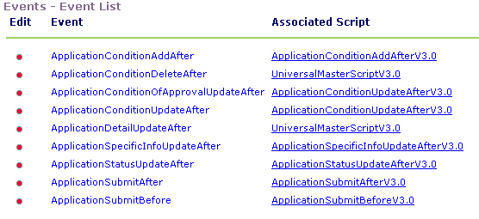
Configurations (2 of 2)
Install:
INCLUDES_CUSTOM
INCLUDES_ACCELA_FUNCTIONS
INCLUDES_ACCELA_FUNCTIONS_ASB
INCLUDES_ACCELA_GLOBALS
Master scripts as needed, assigned to matching event
Store custom global declarations in this optional script

Slide 7
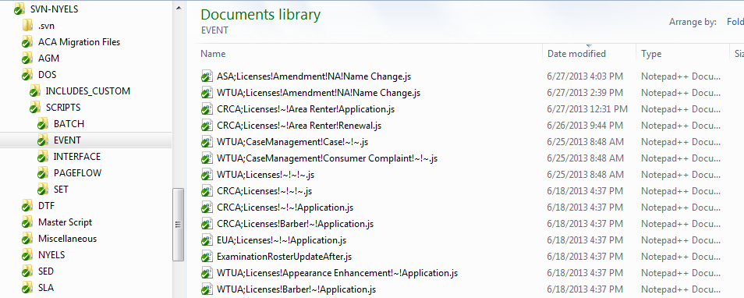
Screen – Local Script Directory
Use the sample folder structure for script and function storage

Slide 8
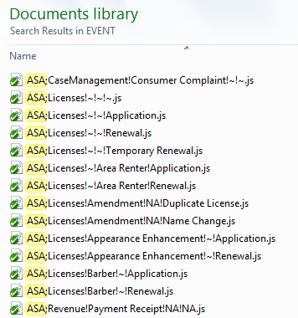
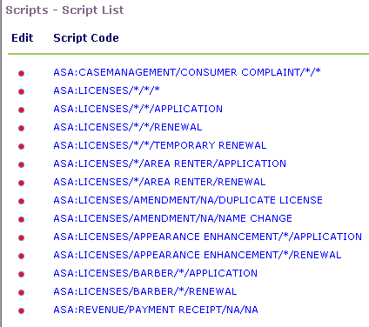
Naming Conventions
Store scripts in the file system using naming convention
Load to Events->Scripts, named exactly as variable branching

Slide 9
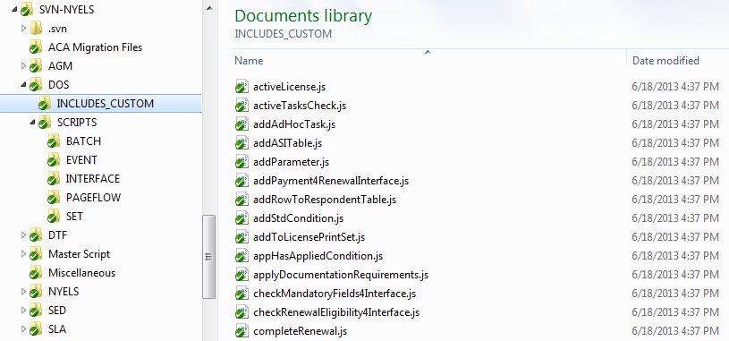
Screen – Includes Directory
Custom functions are stored as individual files in the INCLUDES_CUSTOM folder

Slide 10
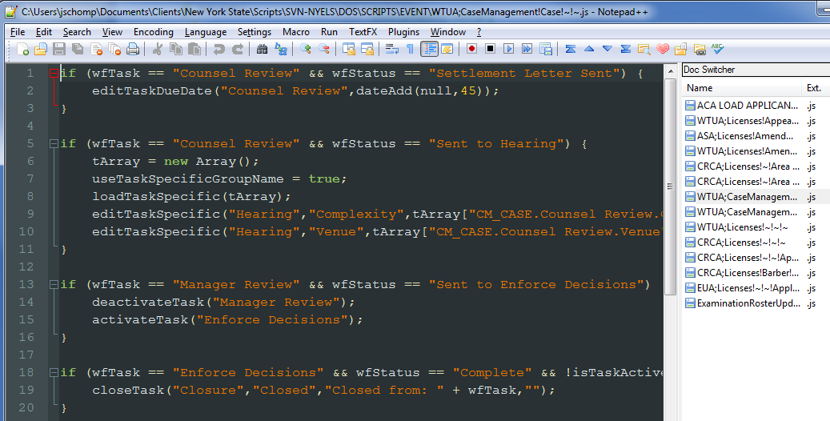
Screen – Local Development
Standard JavaScript can now be used in each file. “Standard Choice” syntax is not required.
ASI Fields are referenced by using Ainfo[“Field”] vs {Field}

Slide 11
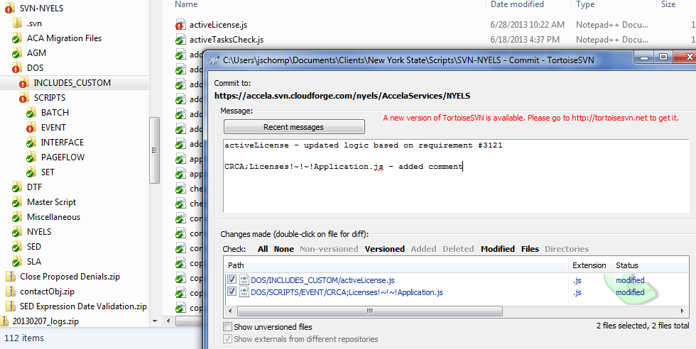
Screen – Checking in Code
Use a version control system (SVN recommended) to manage scripts

Slide 12
Pushing Scripts to Accela Automation
Manually
Commit scripts to repository (SVN)
Update local repository
Manually concatenate all scripts in INCLUDES_CUSTOM to a single file
Manually copy/paste scripts into Accela Automation, rename event scripts to use proper syntax (ASA:Licenses/*/*/*)
Automatic (coming soon)
Accela Automation portlet will poll SVN for updated scripts. Select script to load into AA.

Slide 13
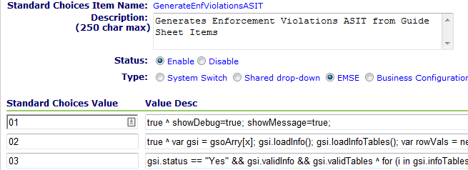
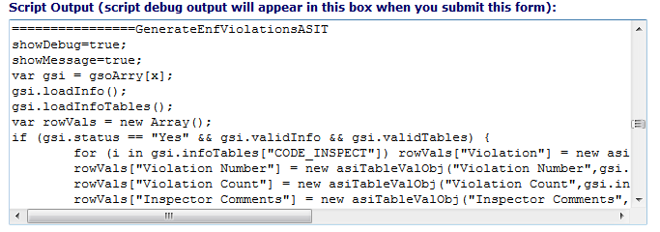
Upgrading existing scripts to 3.0
Existing standard choices are supported
Use the bizdomain to script converter to help migrate standard choices as needed. Clean up converted code, convert branches into custom functions.

